Slide 1
CalConnect XXX Scheduling Workshop
Doug Golub, President – MediSked, LLC
5/21/2014

Slide 2
Scheduling for Home and Community Based Services
Background on MediSked, LLC
Background on Home and Community Based Services
Scheduling Requirements
1:1 Appointments (1 client, 1 employee)
Group Appointments (n clients, n employees)
Residential Settings
Medications
Schedule Data Model
Schedule Algorithm
Workflow and schedule follow-up
Interoperability (HL7, XML)
Messaging between systems
RHIOs/HIEs
Mobile / Calendar Subscriptions

Slide 3
Background on MediSked, LLC
Headquartered in Rochester, N.Y. with satellite offices in Washington, D.C., MediSked, LLC provides human service software solutions specifically for non-medical home- and community-based provider agencies funded through Medicaid Waivers. MediSked’s Software as a Service (SaaS) approach, MediSked Connect, is the leading online Agency Management Platform and the first of its kind in the nation. Other platforms from MediSked, LLC include Coordinate Case Management Platform, Meridian Electronic Health Platform, and Connect Exchange Multi-Agency Business Intelligence Platform.
MediSked, LLC exists to provide consulting services and technological solutions that improve service delivery and quality of care for agencies that provide a full spectrum of lifelong care to those they serve. Established as a resource for navigating Medicaid Reform, MediSked’s Agency Management Platform also offers a technological solution for Medicaid Waiver service providers transitioning to managed care and privatized insurance models.

Slide 4
Background on Home and Community Based Services
Established in section 1915 of Social Security Act
Provides services to individuals meeting eligibility criteria, including:
Personal Care Attendant, Home Health Aide, Companion Care, Residential, Day Programs, Pre-Employment, Employment, Case Management, Transportation, Respite, Therapies, Nursing

Slide 5
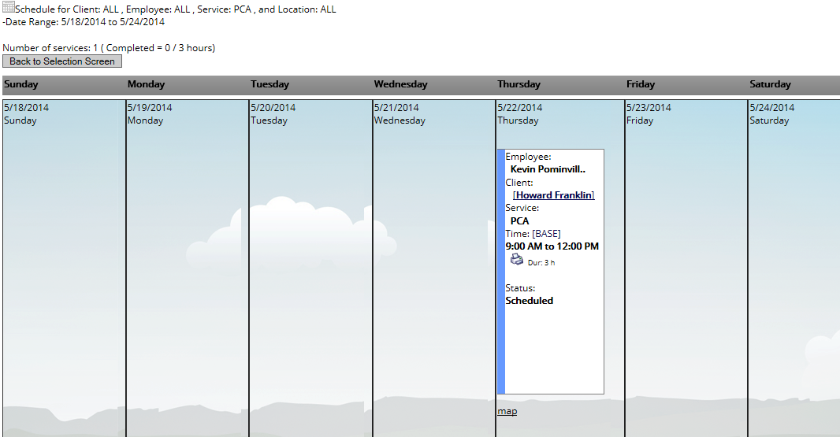
Scheduling Requirements – 1:1 Appointments
Staff time = client time (payable = billable)
Example: home care, counseling, therapy
Exceptions: waiting time, early arrival/early dismissal

Slide 6
Scheduling Requirements – Group Appointments
Potential for multiple staff with multiple clients
Example: group therapy, adult day program
Need for unduplicated staff time, client time
If one staff member works with n clients at the same time, payroll may be skewed if not unduplicated

Slide 7
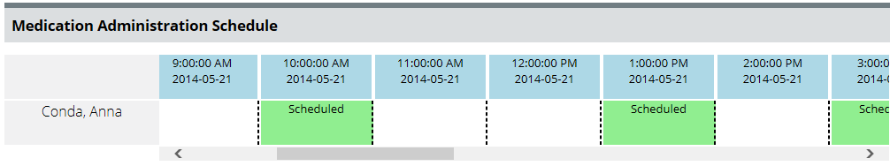
Scheduling Requirements – Medications
Latin frequency: 1X,2X,BID,QID,QIDAC,QIDACHS,QIDHS,QIDPC,QIDPCHS,TID,TIDAC,TIDHS,TIDPC
Recurrence patterns based on as-needed or times per day, versus days per week/month

Slide 8
Schedule Data Model
CREATE TABLE [dbo].[BaseSchedule](
[BlockID] [int] IDENTITY(1,1) NOT NULL,
[DayOfWeek] [int] NOT NULL,
[ServiceID] [int] NOT NULL,
[ClientID] [int] NOT NULL,
[WorkerID] [int] NOT NULL,
[StartTime] [datetime] NOT NULL,
[EndTime] [datetime] NOT NULL,
[BlockActiveStart] [datetime] NOT NULL,
[BlockActiveEnd] [datetime] NULL,
[ChangeBlock] [tinyint] NULL,
[AddUser] [varchar](50) NULL,
[AddTime] [datetime] NULL,
[LocationID] [int] NOT NULL,
[EveryOtherWeek] [int] NULL,
[SchedulingComments] [varchar](500) NULL,
[Posted] [bit] NULL,
[PostedBy] [int] NULL,
[PostedDateTime] [datetime] NULL,
[ReasonID] [int] NULL,
[Reason] [varchar](500) NULL,
[DiffBill] [float] NULL,
[DiffPay] [float] NULL,
[DurationOffset] [int] NOT NULL,
[BaseDeleteTime] [datetime] NULL,
[BaseDeleteUser] [varchar](150) NULL,
[DayOfMonth] [int] NULL,
[WeekOfMonth] [int] NULL,
[LastDayOfMonth] [bit] NULL,
Recurring versus one-time
Recurring schedule that is altered becomes one-time
Schedule versus appointment

Slide 9
Schedule Algorithm
Join table of dates and recurrence pattern
DECLARE @Sequence TABLE
(date datetime, dayofweek int, everyotherweek int, dayofmonth int, weekofmonth int, lastdayofmonth bit);
WITH numbers AS
(
SELECT 0 AS num
UNION ALL
SELECT num +1 FROM numbers
WHERE num < (SELECT DATEDIFF(dd, @local_startdate, @local_enddate))
)

Slide 10
Workflow and Schedule Follow-Up
Certain scheduled activities require follow-up
Within m hours
Within n days
Every o days
Monthly
Quarterly
Etc.

Slide 11
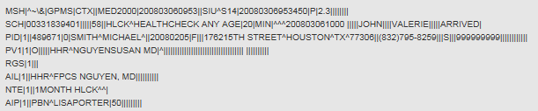
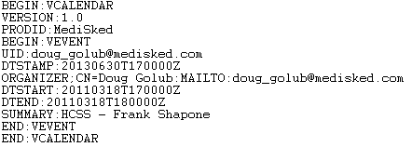
Interoperability
Messaging between systems
HL7
RHIOs/HIEs
CCR/CCD
Mobile / Calendar Subscriptions
iCal

Slide 12
Thank you!
Doug Golub
President – MediSked, LLC
doug_Golub@medisked.com
+1-866-633-4753 x711

